Slide 1
Movie Recommender System, Whatsapp analysis tool & Olympic data analysis tool
Name: Udhav Narendra Patil
Class: TYBSC.CS
Year: 2022-23
Roll No: 27

Slide 2
Movie Recommender System

Slide 3
Introduction
What is Recommender/ Recommendation System?
Let’s clarify this concept by a simple example, suppose you go clothing shop to buy the “Jeans”, then the shopkeeper shows us multiple types, colors, and materials jeans from his shop collections. Then we pick up the one jeans similar to our need and ask the shopkeeper that leads us similar to this pattern, material jeans and then shopkeeper shows us or recommended us the particular type of jeans as per our need this is a recommendation system
Recommender systems are the way of suggesting or similar items and ideas to a user’s specific way of thinking
A Recommender system is a data science problem to predict what the users or customers want based on the historical data. Learning recommendation system could be better with python package to accompany our studies

Slide 4
Scope of Project
For the past year we are in our house due to a pandemic so most of our time we will spend watching mobile or watching movies and series with family or alone. But at that time it’s hard for us to select which movie we should watch because we have so many options but we are confused about what movie is similar to the content of the other movies or if you like one movie and you would like to similar genera movie how we find? So there my website will guide you, you just have to select a movie that you watch and then the website automatically recommended you a similar type of movie using the Machine learning model. It will ease our needs and reduce the effort of finding a movies
The movie recommender system uses the movie dataset and with the help of Machine learning model to process the data and handle that data using the concept of data science, we create a website where you should select the movie and similar to that movie we give a proper recommendation
A Recommender System refers to a system that is capable of predicting the future preference of a set of items for a user and recommending the top items. One key reason why we need a recommender system in modern society is that people have too many options to use due to the prevalence of the Internet.

Slide 5
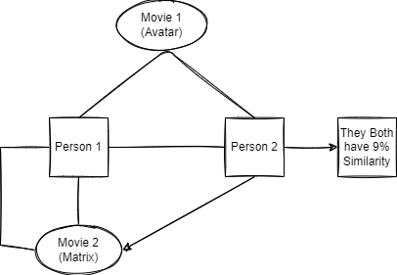
Types Of Recommender System
Content Based
It will Recommend ate on the bases of content similarity, In this system we used tags for recommendation
Collaborative filtering
It will recommend ate on users interests, lets clear the concept with one example there is 2 person they both have similarity like 9% they both like Avatar movie and there rating for this movie is same then if suppose person 1 watch matrix movie and he like that movie then collaborative filtrating recommend ate person2 a similar movie
Hybrid
It is mixture of both content based and collaborative filtering recommendation system
“In This Project we use content based recommendation system using and add tags to our movie data set”

Slide 6
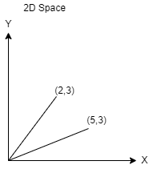
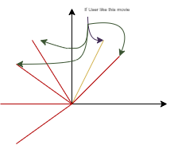
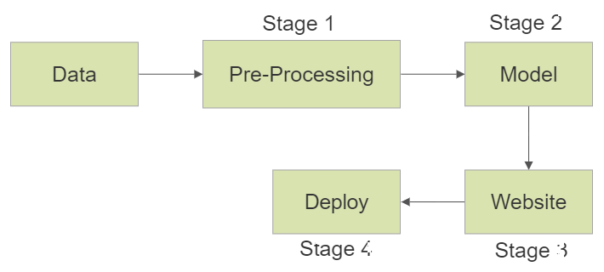
CORE idea
We have data in way like “movie id”, “names” and “tags” like this format we have 5000 movie.
now to use this data set in proper form we try to convert tags in vector form.
suppose user like 2,3 movie then my recommendation system will show them closet vector or similar tags movies
To converting text into vector the method know as “textvectorization” to do textvectorization we have many format
Bag of word
tf idf
word to vector
For this model we use bag of word method to convert text Into vector

Slide 7
Tools for project
For Movie Collection we use “TMDB 5000 Movie Dataset” for processing ML model
We use python language for this project
Jupiter notebook(IDE) for creating the ML model
Pycharm (IDE) for creating a frontend or web app for the movie recommender system
And for this project we use a new framework known as “Streamlit” it helps us create a web app for data science and machine learning in a short time
Heroku(website) for web services and project deployment and hosting the project free of cost

Slide 8
Whatsapp chat Analysis

Slide 9
Introduction
In this website we created a data analysis tool using python so we can take detail analysis of our what a group chat or individual chat
The idea behind creating a website so simple that we have so many data around us now a day but we didn’t know how to process that data or use this data
In this website we just have to export Whatsapp data file and its will give us detail analysis about that Whatsapp data in the form of numeric, different types of graph and most use word world cloud and etc.

Slide 10
Why This project
We are living in a information era so basically we have so many data around us and so many company capitalize using this data we basically we have to know how to process the data and how to present in proper manner
This project consist of so many aspect of data science and it will help us to deal with a big dataset or we can say our current live data set
In this project we use Whatsapp chat dataset so basically there are so many thing about data science we can learn from this like data handling, data cleaning, sorting, data presentation etc.
And it fill help us to learn how to work on different-different types of data set

Slide 11
Why this is different from existing system
Like instragram, Whatsapp didn’t have yet a insight feature so basally it will help us to know insight about our chartroom
It tool can be use in cyber forensic also where we can analysis a data of particular suspicious Whatsapp group and learn or analysis there data and as per data we know we spreading a wrong data through Whatsapp group and we know there member past activity in the group
We can learn there measure chat timing, common used word and most online person from the group etc.
We can know individual information and combined information also through website and we know each person how many time they send any link or media file and messages also

Slide 12
Tools for project
For Whatsapp Chat data we use our personal chat data given by Whatsapp
We use python language for this project
Jupiter notebook(IDE) for creating the ML model or backend
Pycharm (IDE) for creating a frontend or web app for the movie recommender system
And for this project we use a new framework known as “Streamlit” it helps us create a web app for data science and machine learning in a short time
Heroku(website) for web services and project deployment and hosting the project free of cost

Slide 13
Olympics data analysis

Slide 14
Introduction
When we were watching Olympics game there are so many confusion on that one screen we cant find proper information that we want or regarding what topic we want so in this Olympics data analysis tool we used Olympics dataset and create a analysis website there you can easily find information regarding what you are interested or which country sport player are you trying to find data
In analysis tool we can do mainly 4 type of analysis on Olympic data -Medal tally, - Overall analysis, -country wise analysis, - Athlete Wise analysis
It will show a statics and numerical data of Olympic sport and their winning and losing performance as per year and player
We use different types of graphs to present our data as per need
Basely its data analysis tool in form of website

Slide 15
Why This project
We are living in a information era so basically we have so many data around us and so many company capitalize using this data we basically we have to know how to process the data and how to present in proper manner
This project consist of so many aspect of data science and it will help us to deal with a big dataset
In this project we use 120year Olympic dataset so basically there are so many thing about data science we can learn from this like data handling, data cleaning, sorting, data presentation etc.
And this information era everyone from computer background should know about data science and data handling because data is the future

Slide 16
Why this is different from existing system
This is basically tool where I analysis a data
Other sports information website show a minimum data that user want see but for deep knowledge we can find detail analysis in this website
Way of presentation of data and their graphs a better than existing system
Its particular website in this we created a analysis tool, no other existing system done that job before
It didn’t use old school methods to create a website we will just use library called Streamlit and it well give a basic website where I can setup my analysis tool without any other programming language required

Slide 17
Tools for project
For Olympics data Collection we use “120 Year of Olympic history” dataset.
We use python language for this project
Jupiter notebook(IDE) for creating the ML model or backend
Pycharm (IDE) for creating a frontend or web app for the movie recommender system
And for this project we use a new framework known as “Streamlit” it helps us create a web app for data science and machine learning in a short time
Heroku(website) for web services and project deployment and hosting the project free of cost

Slide 18
Thank You

